Slide 1


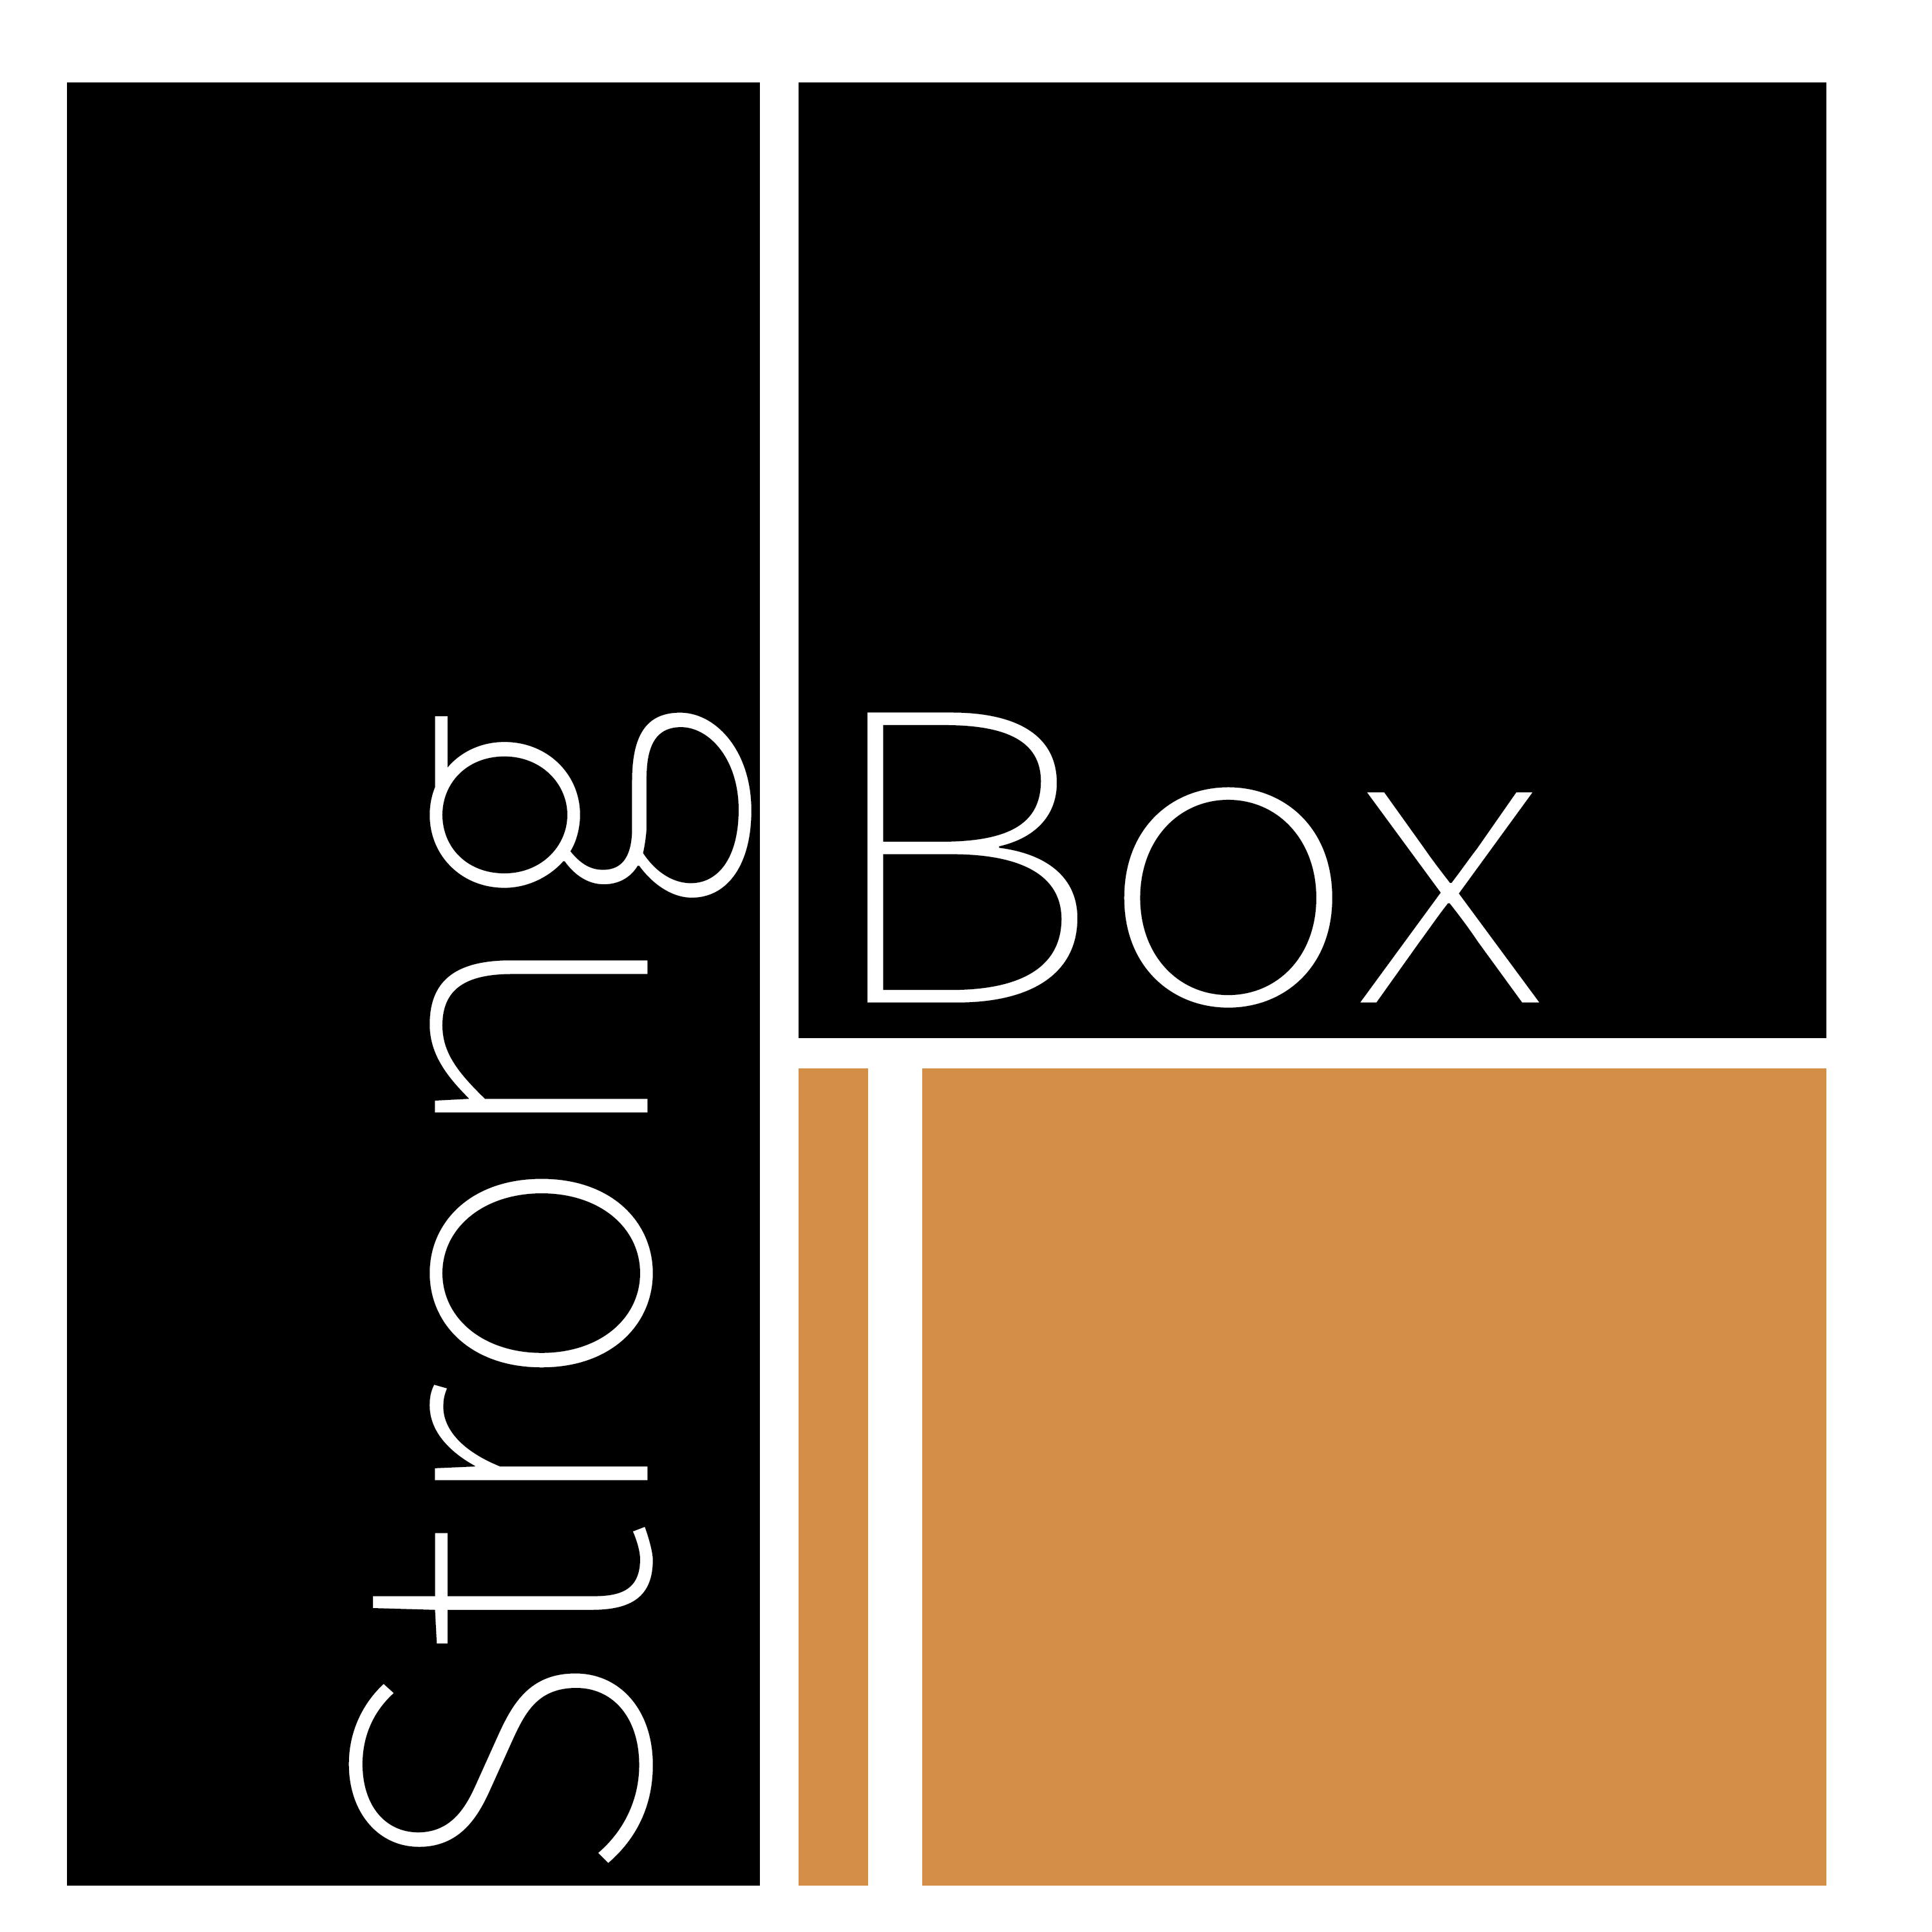

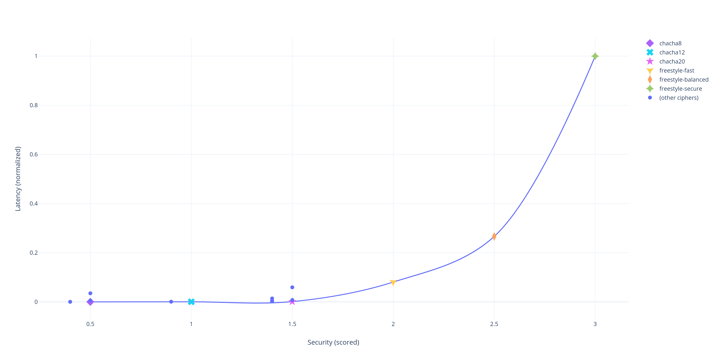
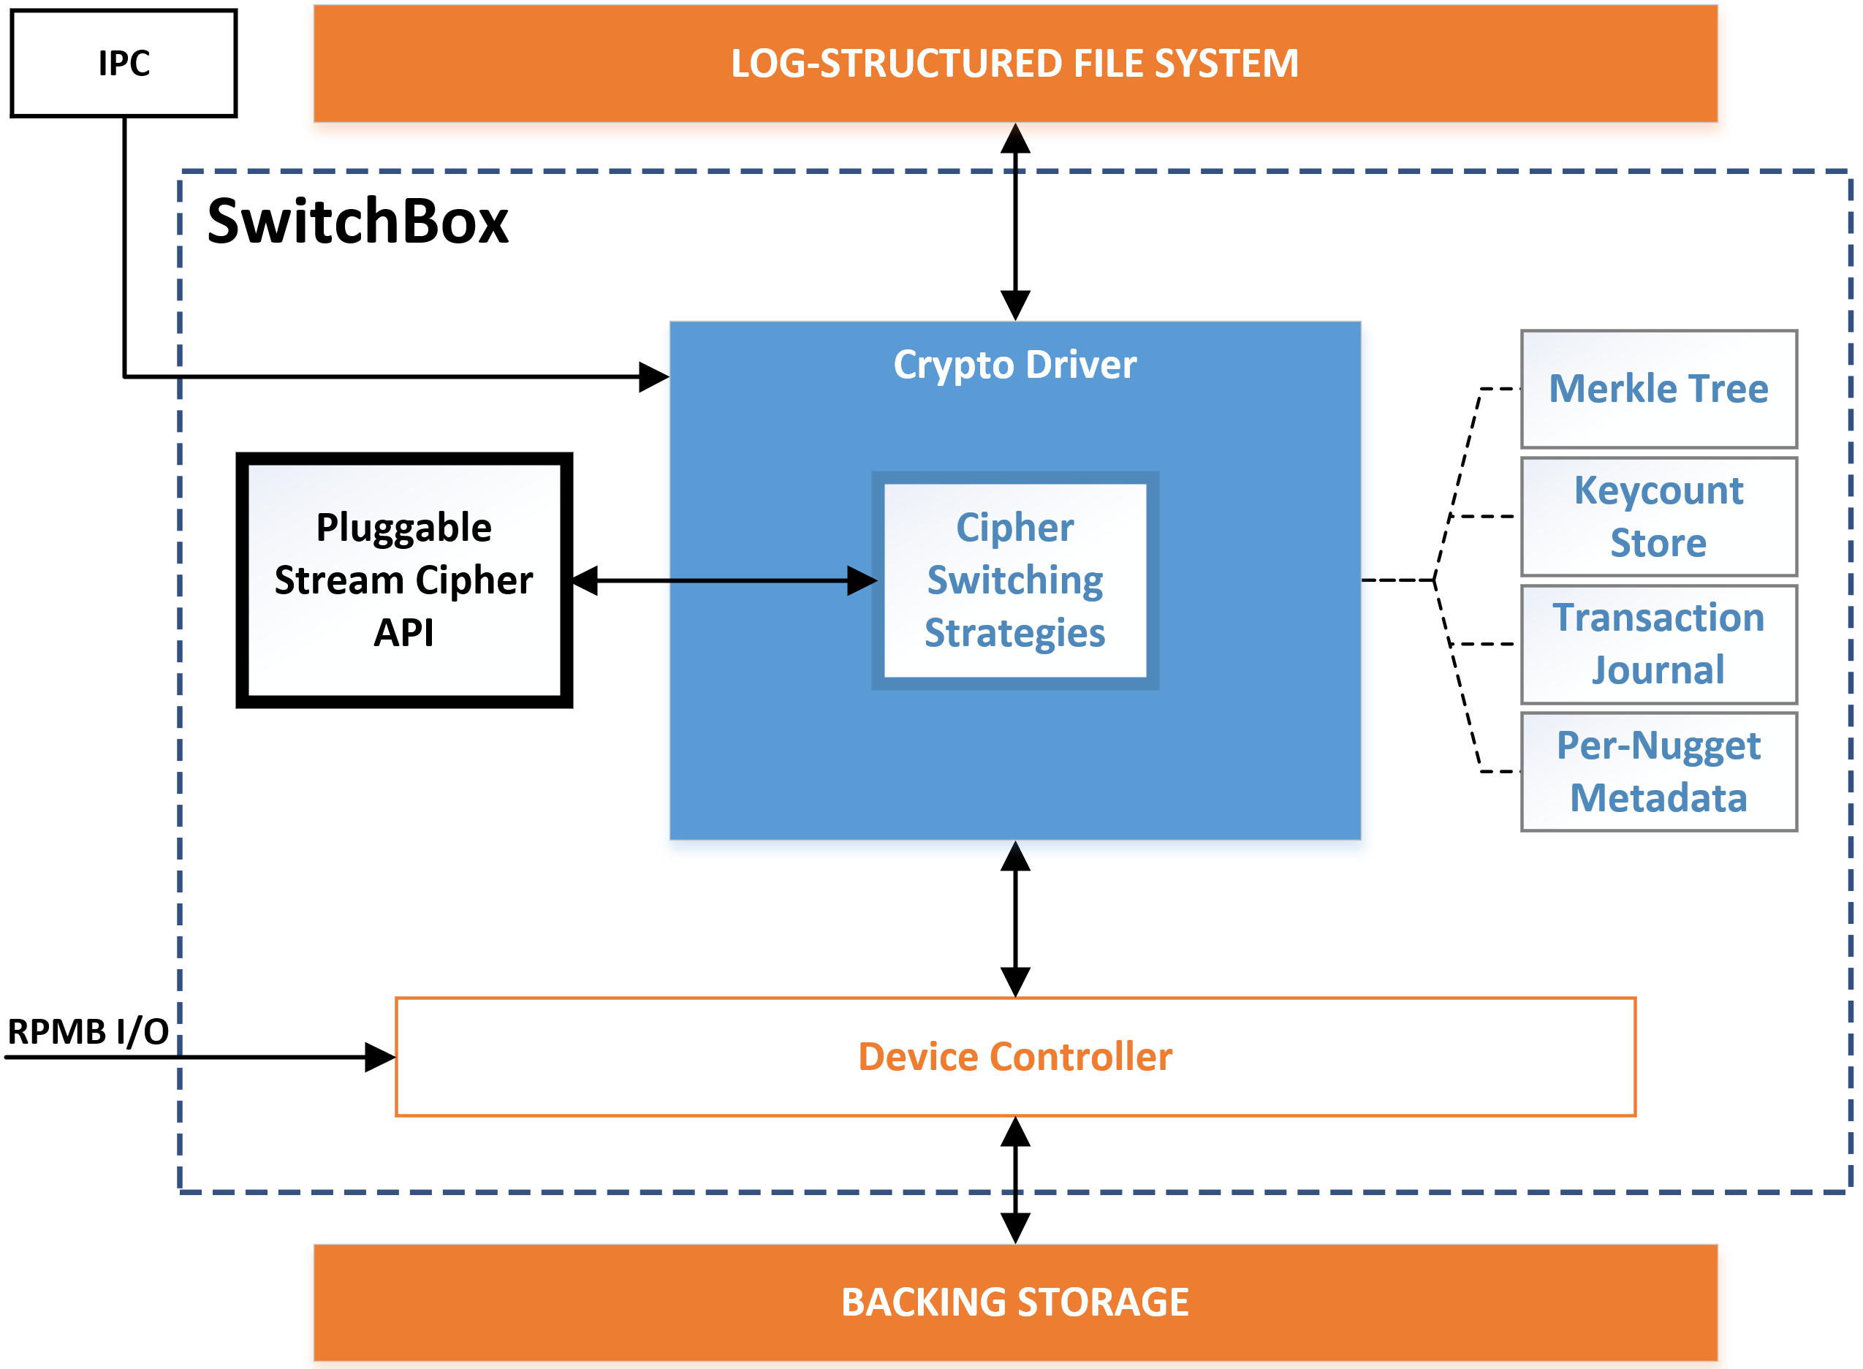
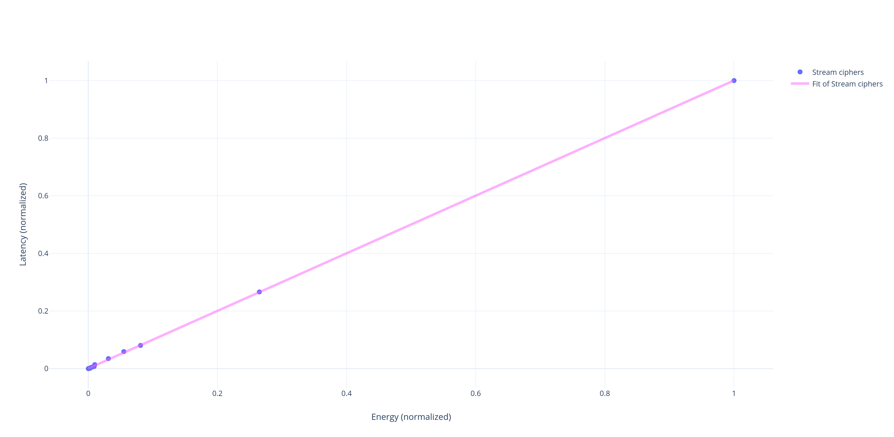
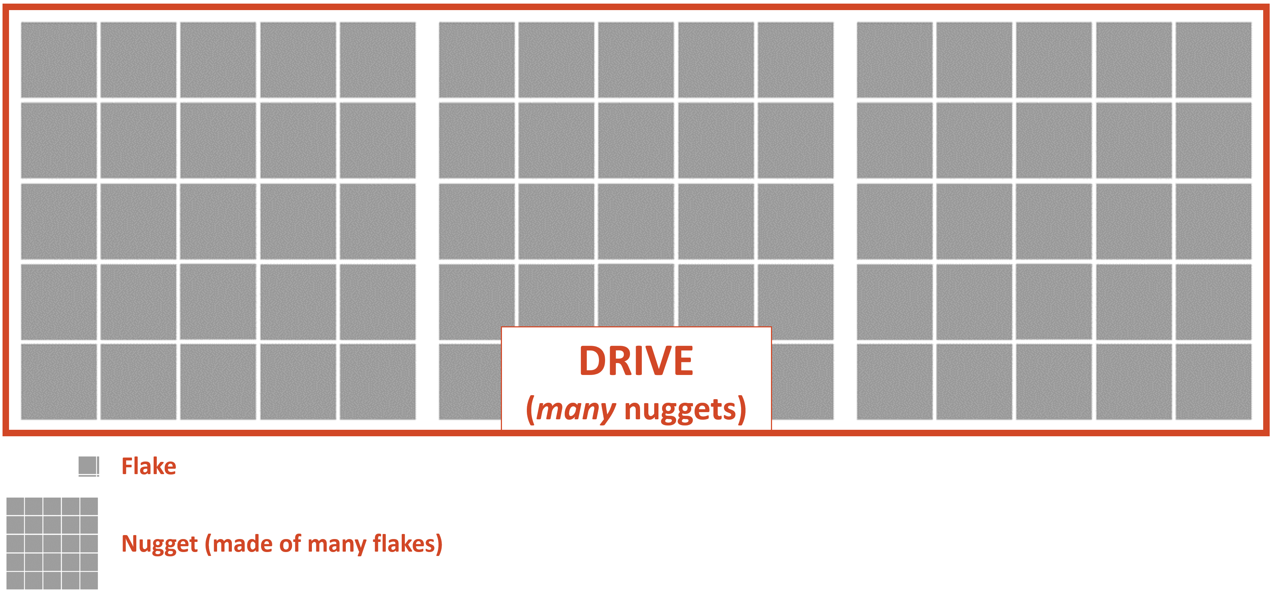
StrongBox II: Navigating Tradeoffs in Stream Cipher Based Full Drive Encryption
AKA: SwitchBox
Bernard Dickens III, Haryadi S. Gunawi, David Cash, Hank Hoffmann
Leveraging LFS/FTL behavior, we can trade off drive performance and battery life versus desired security properties with low overhead!
Full Drive Encryption (FDE) is essential for security in modern mobile systems. Stream cipher based FDE
shows improved performance (StrongBox), but more optimal FDE requires navigating a tradeoff space of different stream cipher configurations. We present a software mechanism to navigate such a space dynamically via cipher switching.
Your Data:
1
1
1
0
0
1
0
0
⊕
Keystream:
0
1
0
0
1
1
0
1
=
Encrypted:
Encryption process: how a stream cipher works to encrypt data
MOTIVATION
KEY INSIGHTS
StrongBox with ChaCha20 represents only a single point in a space of cipher configurations
Encryption/decryption and re-keying of nuggets are entirely independent operations
The optimal cipher configuration point might not be fixed
To remain at the optimal cipher configuration, we must trade off between different cipher configurations online with cipher switching
Low overhead switching requires certain switching strategies
DESIGN & DRIVE LAYOUT
> Cipher configuration space vs latency shows a rich tradeoff space between latency and choice of cipher configuration. There is slack to exploit!
> Prior work can only accomplish a static tradeoff at compile time or at system initialization
> Prior work cannot reach points between configurations, even if more optimal
> StrongBox re-keying can be abstracted out into re-ciphering to navigate tradeoff space
StrongBox is a translation layer ideally implemented in the Flash Translation Layer (FTL) or device controller. It provides a mechanism to navigate our tradeoff space.
> Merkle Tree, Keycount store, Transaction Journal, and Metadata store enable low overhead secure I/O with any cipher using the Stream Cipher API and secure hardware
> Nugget contents are considered distinct units in the backing store; they are encrypted and decrypted independently. Re-ciphering one nugget does not impact any of the others
Cipher Configuration Space: Latency Tradeoff
StrongBox II (SwitchBox) Design
CASE STUDIES
There are a variety of cases where cipher switching may be useful. We study:
> Responding to “power saving mode”. When our mobile devices enter power saving mode, can the filesystem do the same? We can switch to a more energy-efficient cipher.
> Responding to end-of-life slowdown in SSDs. If the SSD performance is noticeably degrading, we can switch to a higher performance cipher to offset latency.
> Responding to variable data sensitivity. Some parts of a file, or some files on a system, may be much more sensitive than others. We can encrypt them differently.
> Responding to device custody panic. If our mobile device leaves our custody unexpectedly, we can remotely wipe it, especially if we were using a weaker cipher. But this is not ideal in all cases. Can we switch to a stronger cipher and “lock it down” instead?
Cipher Configuration Space: Latency v Energy
StrongBox Backing Store/SSD Layout

